Slide 1
Group 8
Saul Rodriguez-Tapia, Aryan Chauhan, Aaron Hodzic

Slide 2
Why we chose our topic
Objective
By tracking glaciers we can understand patterns in Earth’s atmospheric temperature, sea level, and precipitation, making them the ideal way to track the evolution of global climate
Significance
Glaciers also play a vital role in regional water cycles, affecting many reaches of the world both in their acting as natural reservoirs for mountainous regions and in their influence on weather patterns across the globe
Tracking the size of glaciers throughout the years helps researchers and the general public understand the significant impacts of climate change and global warming.

Slide 3
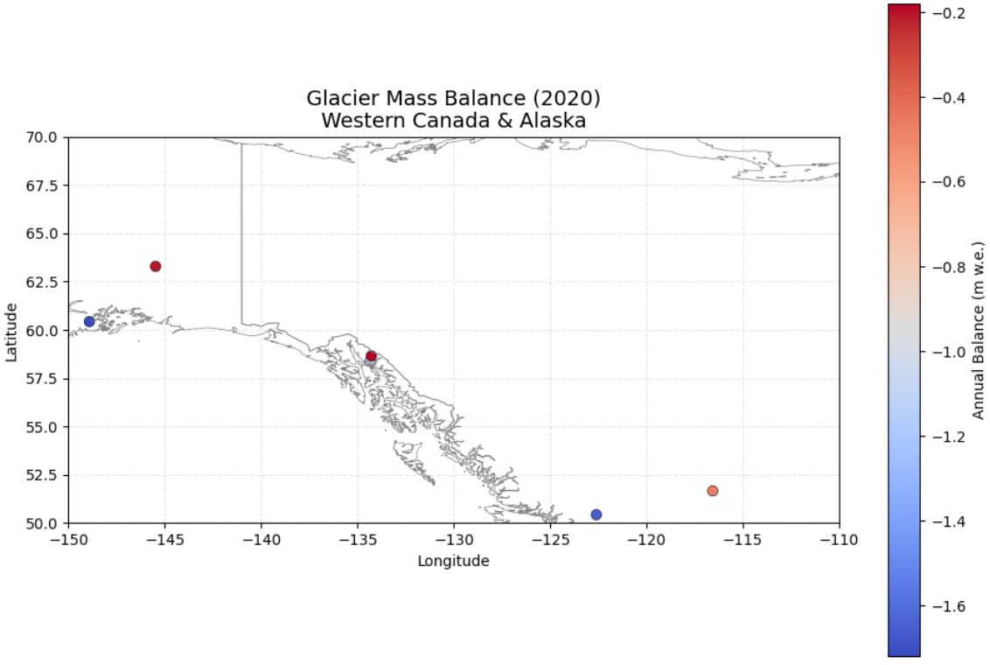
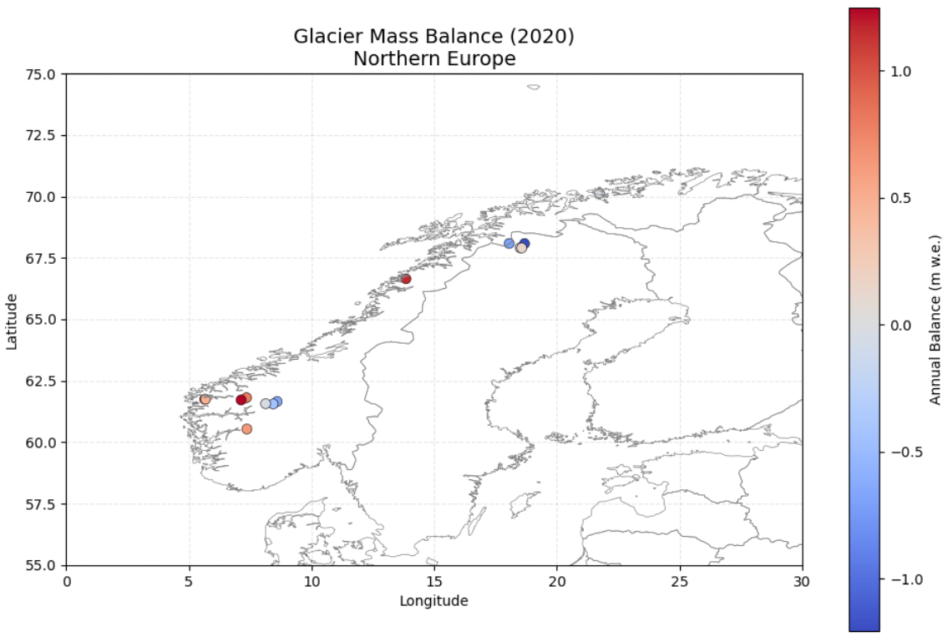
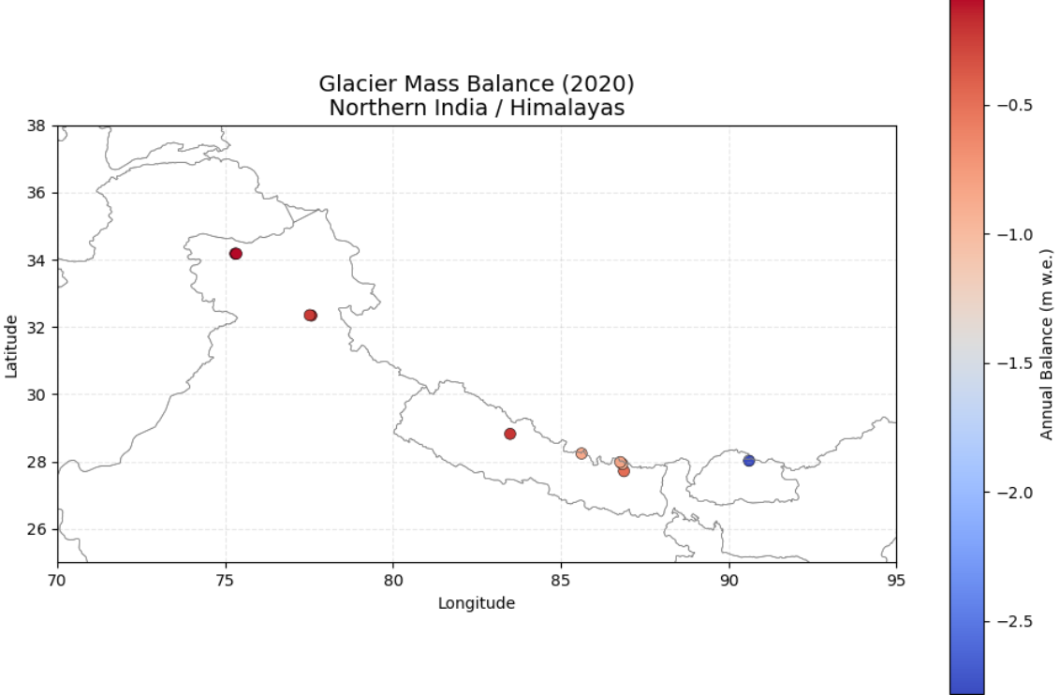
Visual Results 1

Slide 4
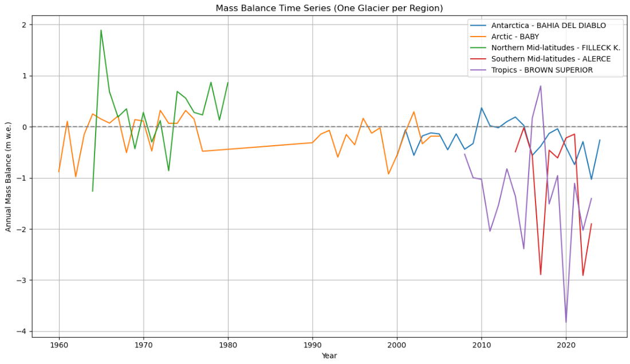
Visual Results 2

Slide 5
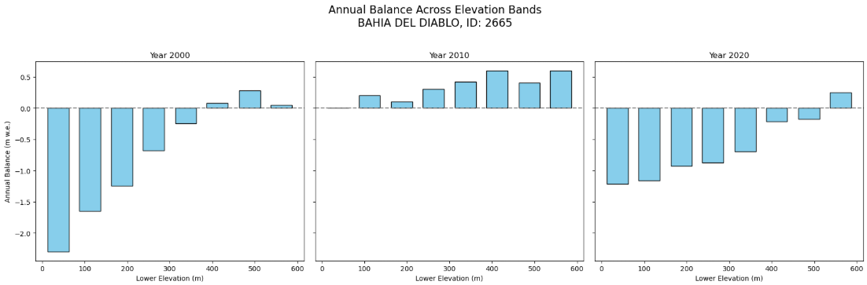
Visual Results 3

Slide 6
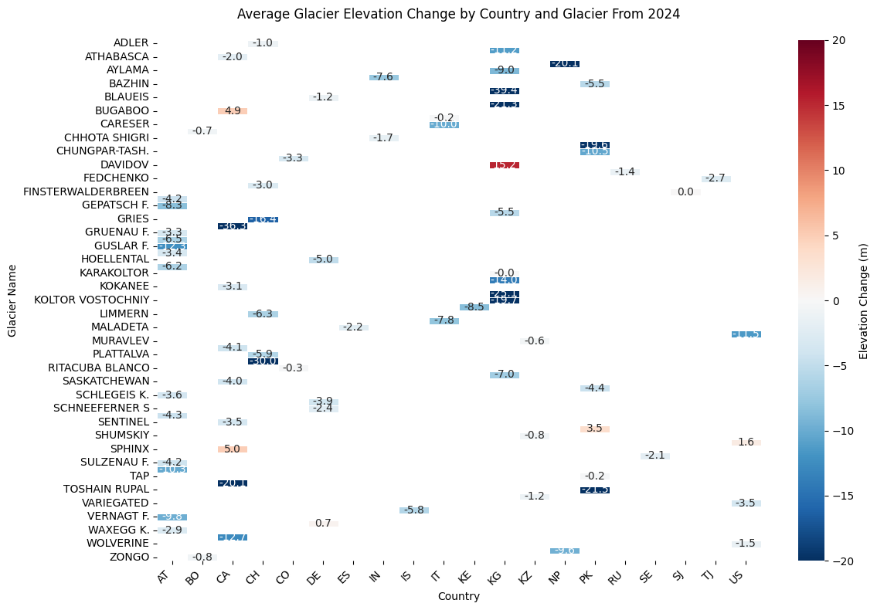
Visual Results 4

Slide 7
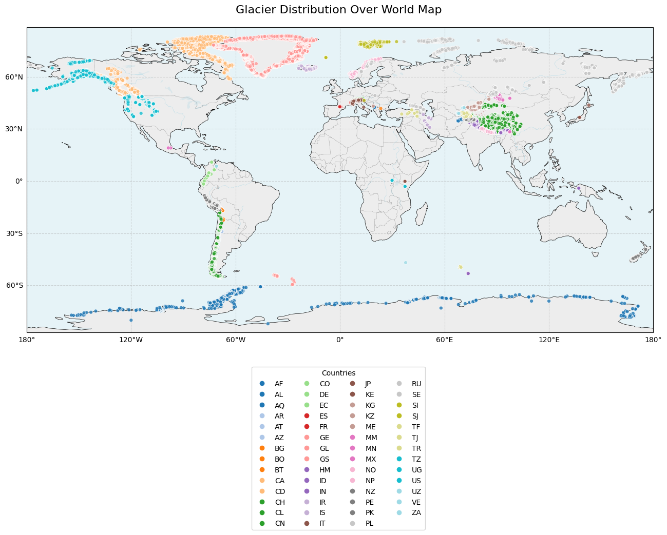
Visualization 5

Slide 8
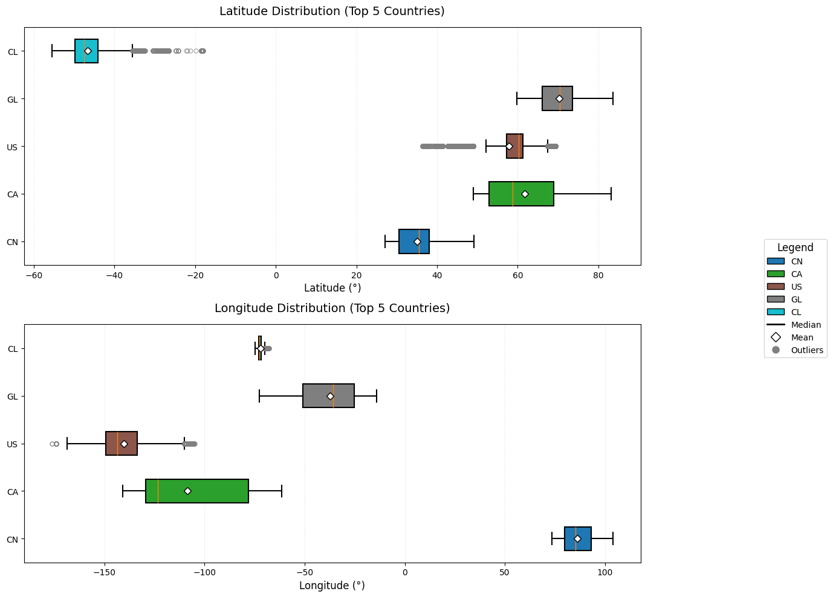
Visualization 6

Slide 9
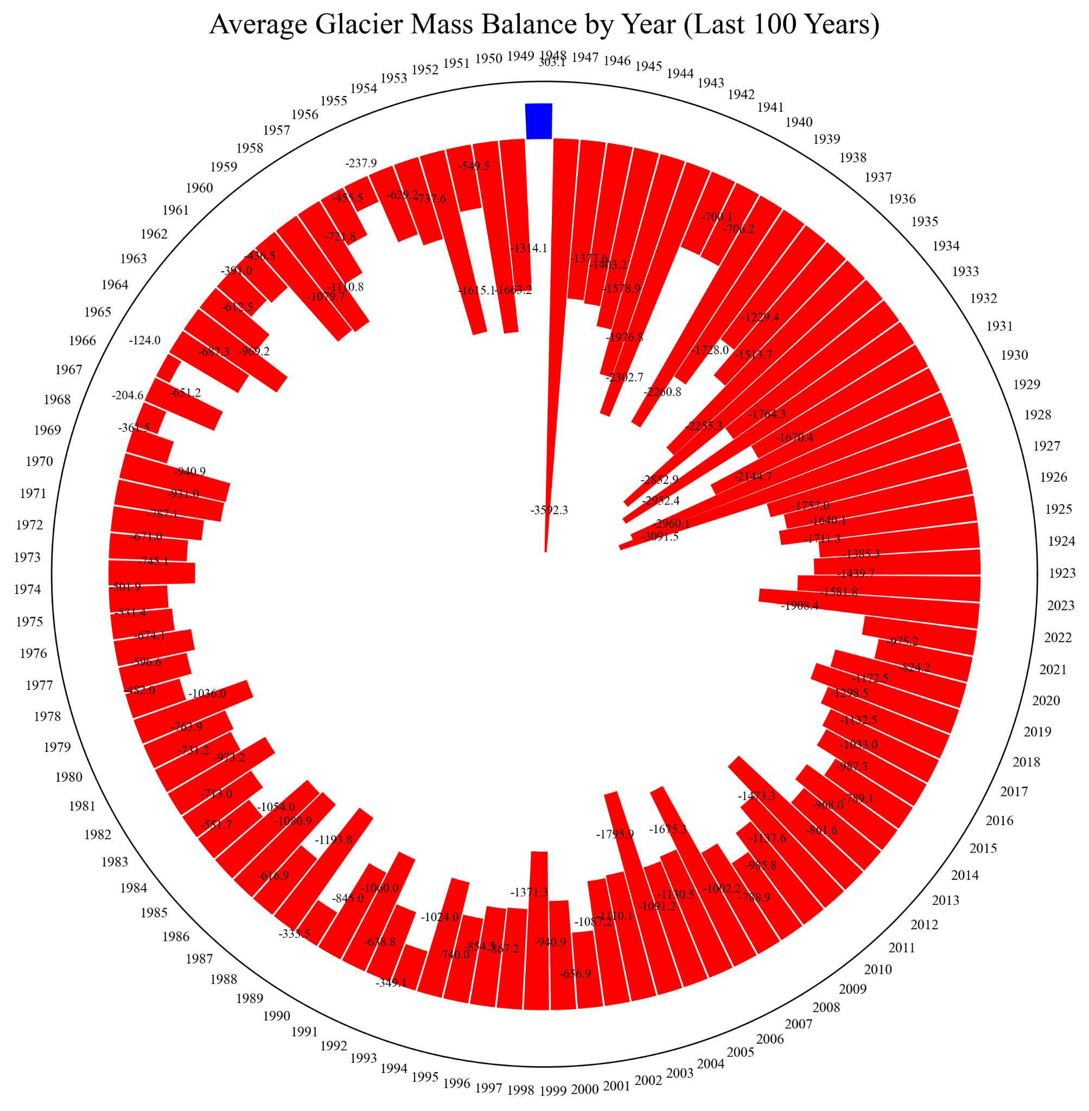
Visualization 7
(radial timeline)
Goal: Highlights cyclical or abrupt changes in mass by displaying glacier mass changes over centuries in a circular timeline.
Structure: To illustrate temporal patterns, each bar is positioned radially by time and represents the mass change in a particular year.
Color mapping: The degree of mass gain or loss is conveyed by a cool-to-warm color gradient (red = loss, blue = gain).
Insight: Shows that the glacier mass balance has decreased significantly since the mid-20th century
Why It Is Important: valuable for pinpointing periods of rapid melting or stabilization, particularly in the context of long-term climate monitoring.

Slide 10
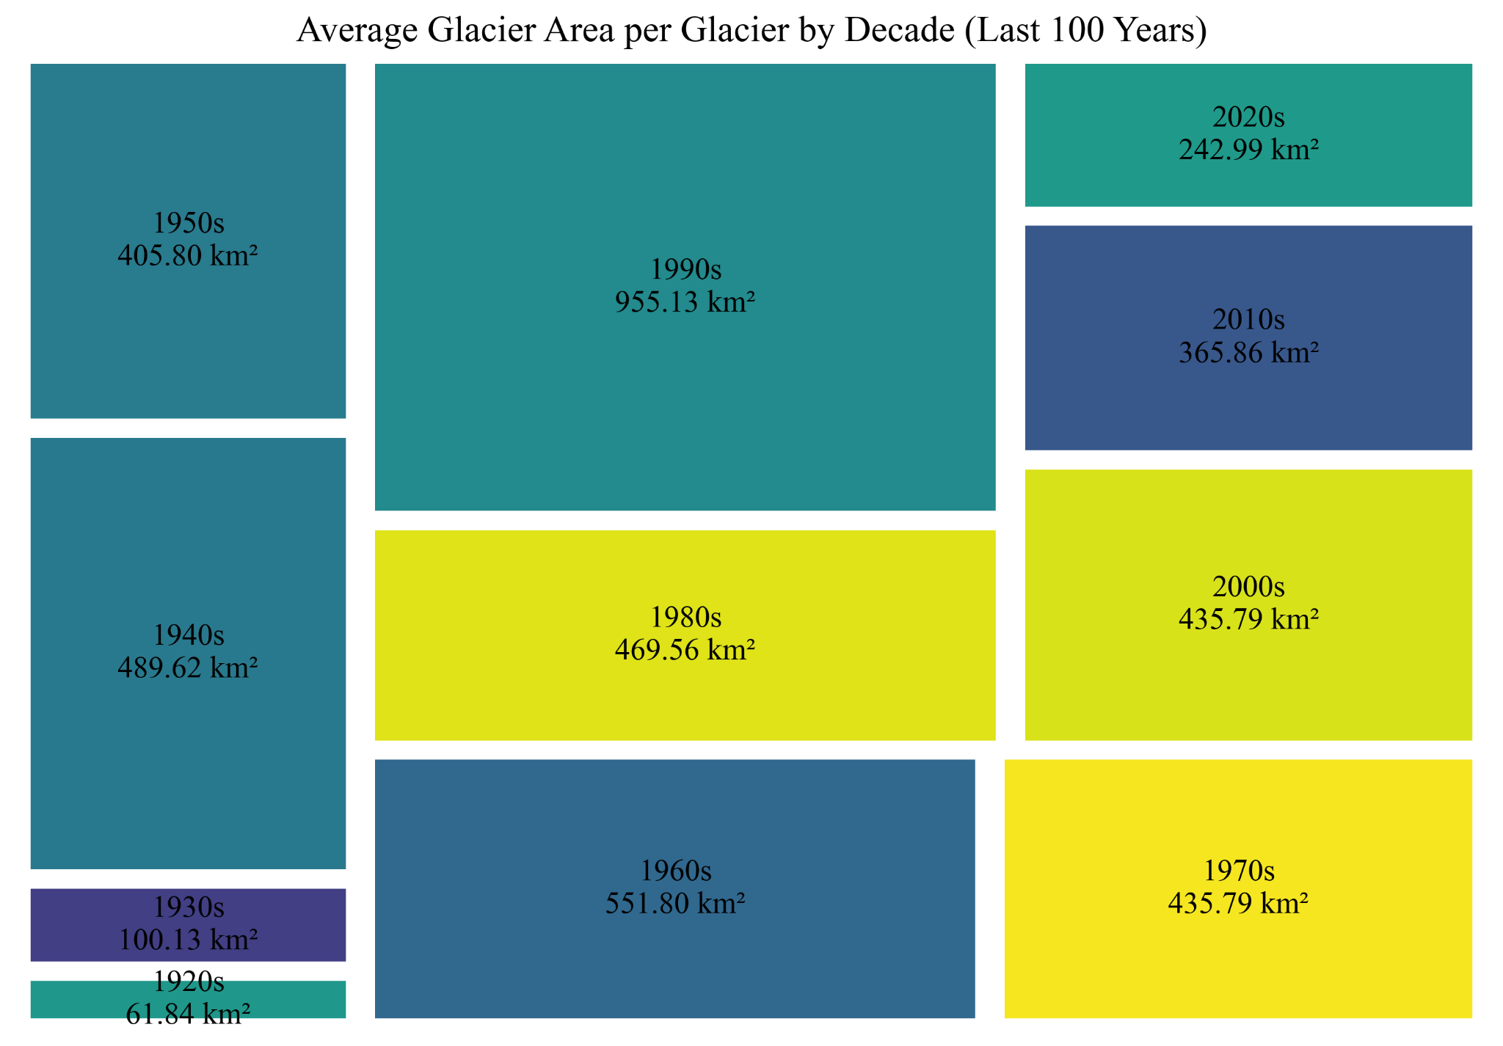
Visualization 8
Goal: to compare glacier metrics (mass, volume, area, and length) by century in terms of their relative sizes.
Structure: To emphasize temporal proportions, nested rectangles group each metric's magnitude within centuries.
Insight: Shows that the average area of the glaciers by decade has decreased from the early 20th century to the early 21st century, most significantly from the 90s to the 2000s.
Labeling: To facilitate visual decoding and accurate comparison, each section includes the century, metric, and exact value.
Why It Matters: Makes it possible to comprehend how glacier structural changes have changed over time, such as whether volume has decreased more precipitously in recent centuries than area or length.

Slide 11
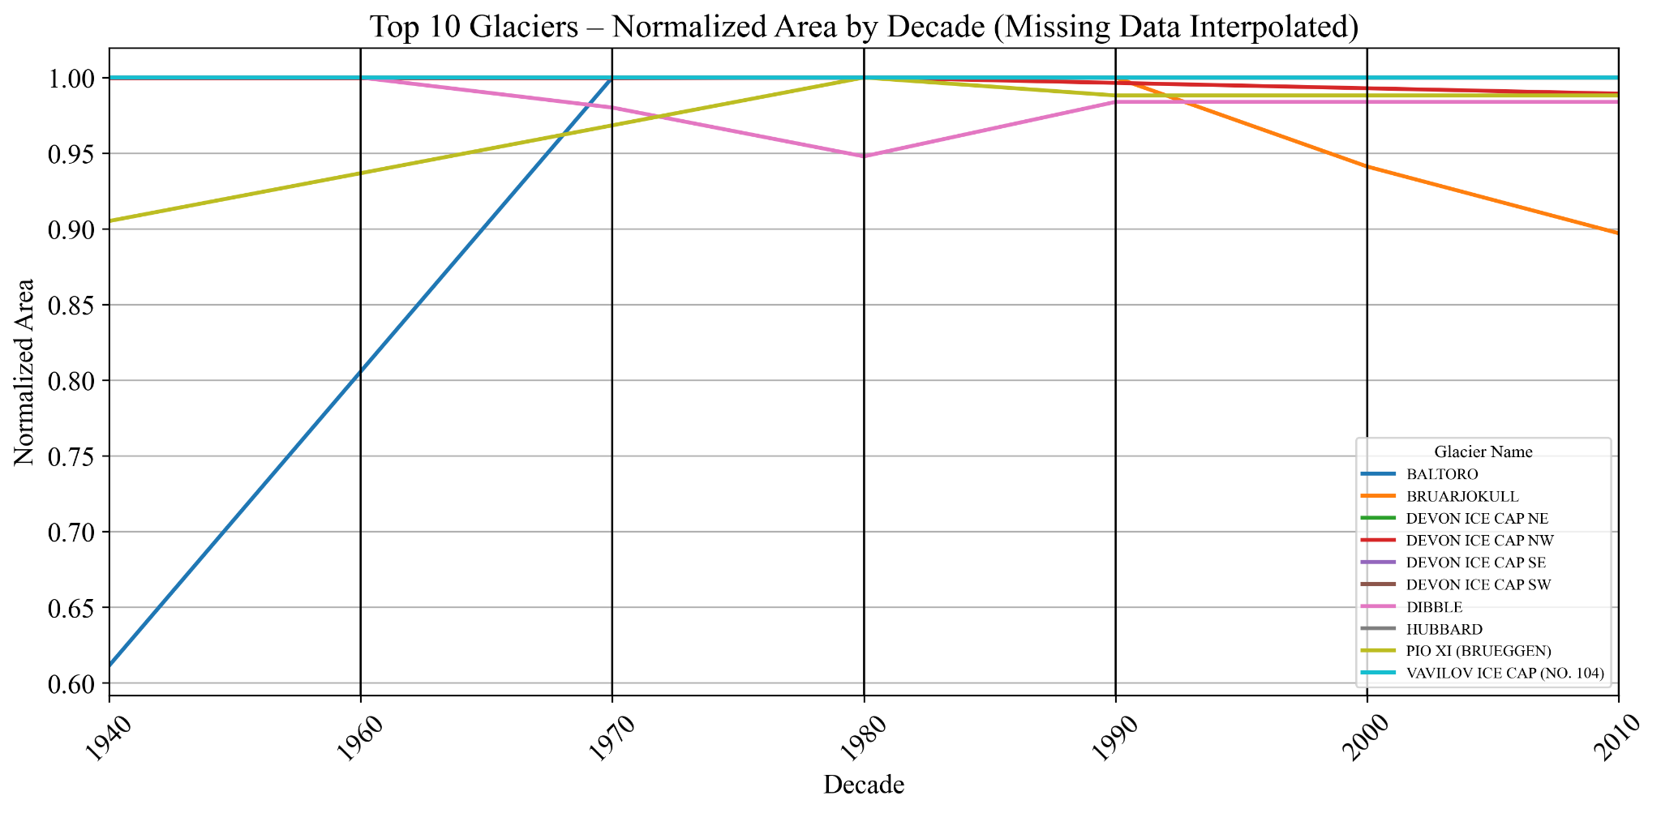
Visualization 9
Goal: Illustrates how four important glacier metrics changed in tandem (or apart) over significant historical epochs.
Structure: It is simple to follow patterns and correlations because each line joins standardized metric values for a single epoch.
Insight: Annotations give quantitative context for visual trends by displaying actual (not normalized) values.
Metrics: Even though different metric scales (such as mass vs. area) exist, normalization allows for fair comparison.
Why It Matters: Indicates interdependencies in the dynamics of glacier retreat by demonstrating the strong correlation between metrics such as mass and volume in loss trends.

Slide 12
Key Insights
Overall most glaciers are melting faster than they’re gaining snow/ice, this demonstrates a global glacier retreat
Glaciers closer to the poles show less negative balances (melt less)

Slide 13
Works Cited
WGMS (2025): Fluctuations of Glaciers (FoG) Database. World Glacier Monitoring Service (WGMS), Zurich, Switzerland. https://doi.org/10.5904/wgms-fog-2025-02b

